Slide 1
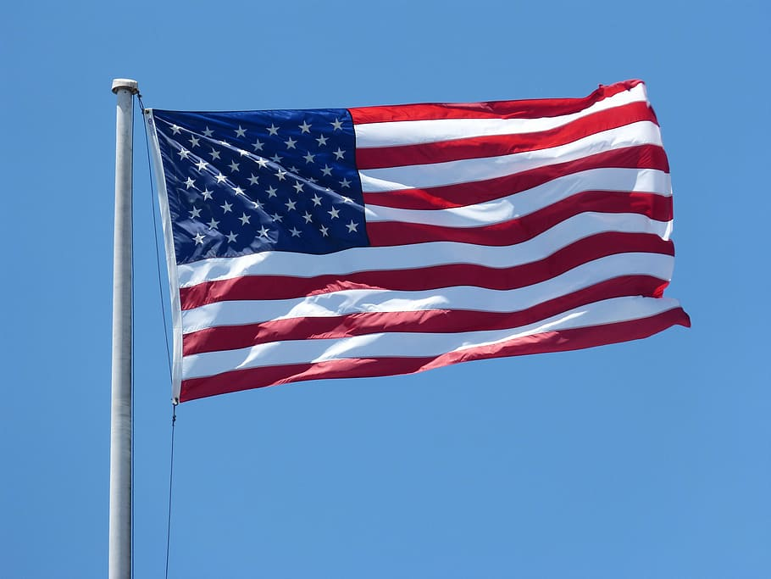
American Culture
Understanding Cultural Differences
Presentation created by Laura Halverson, JPJMS

Slide 2
Americans don’t kiss when they meet each other. They usually shake hands.

Slide 3
Americans think being on time is important.

Slide 4
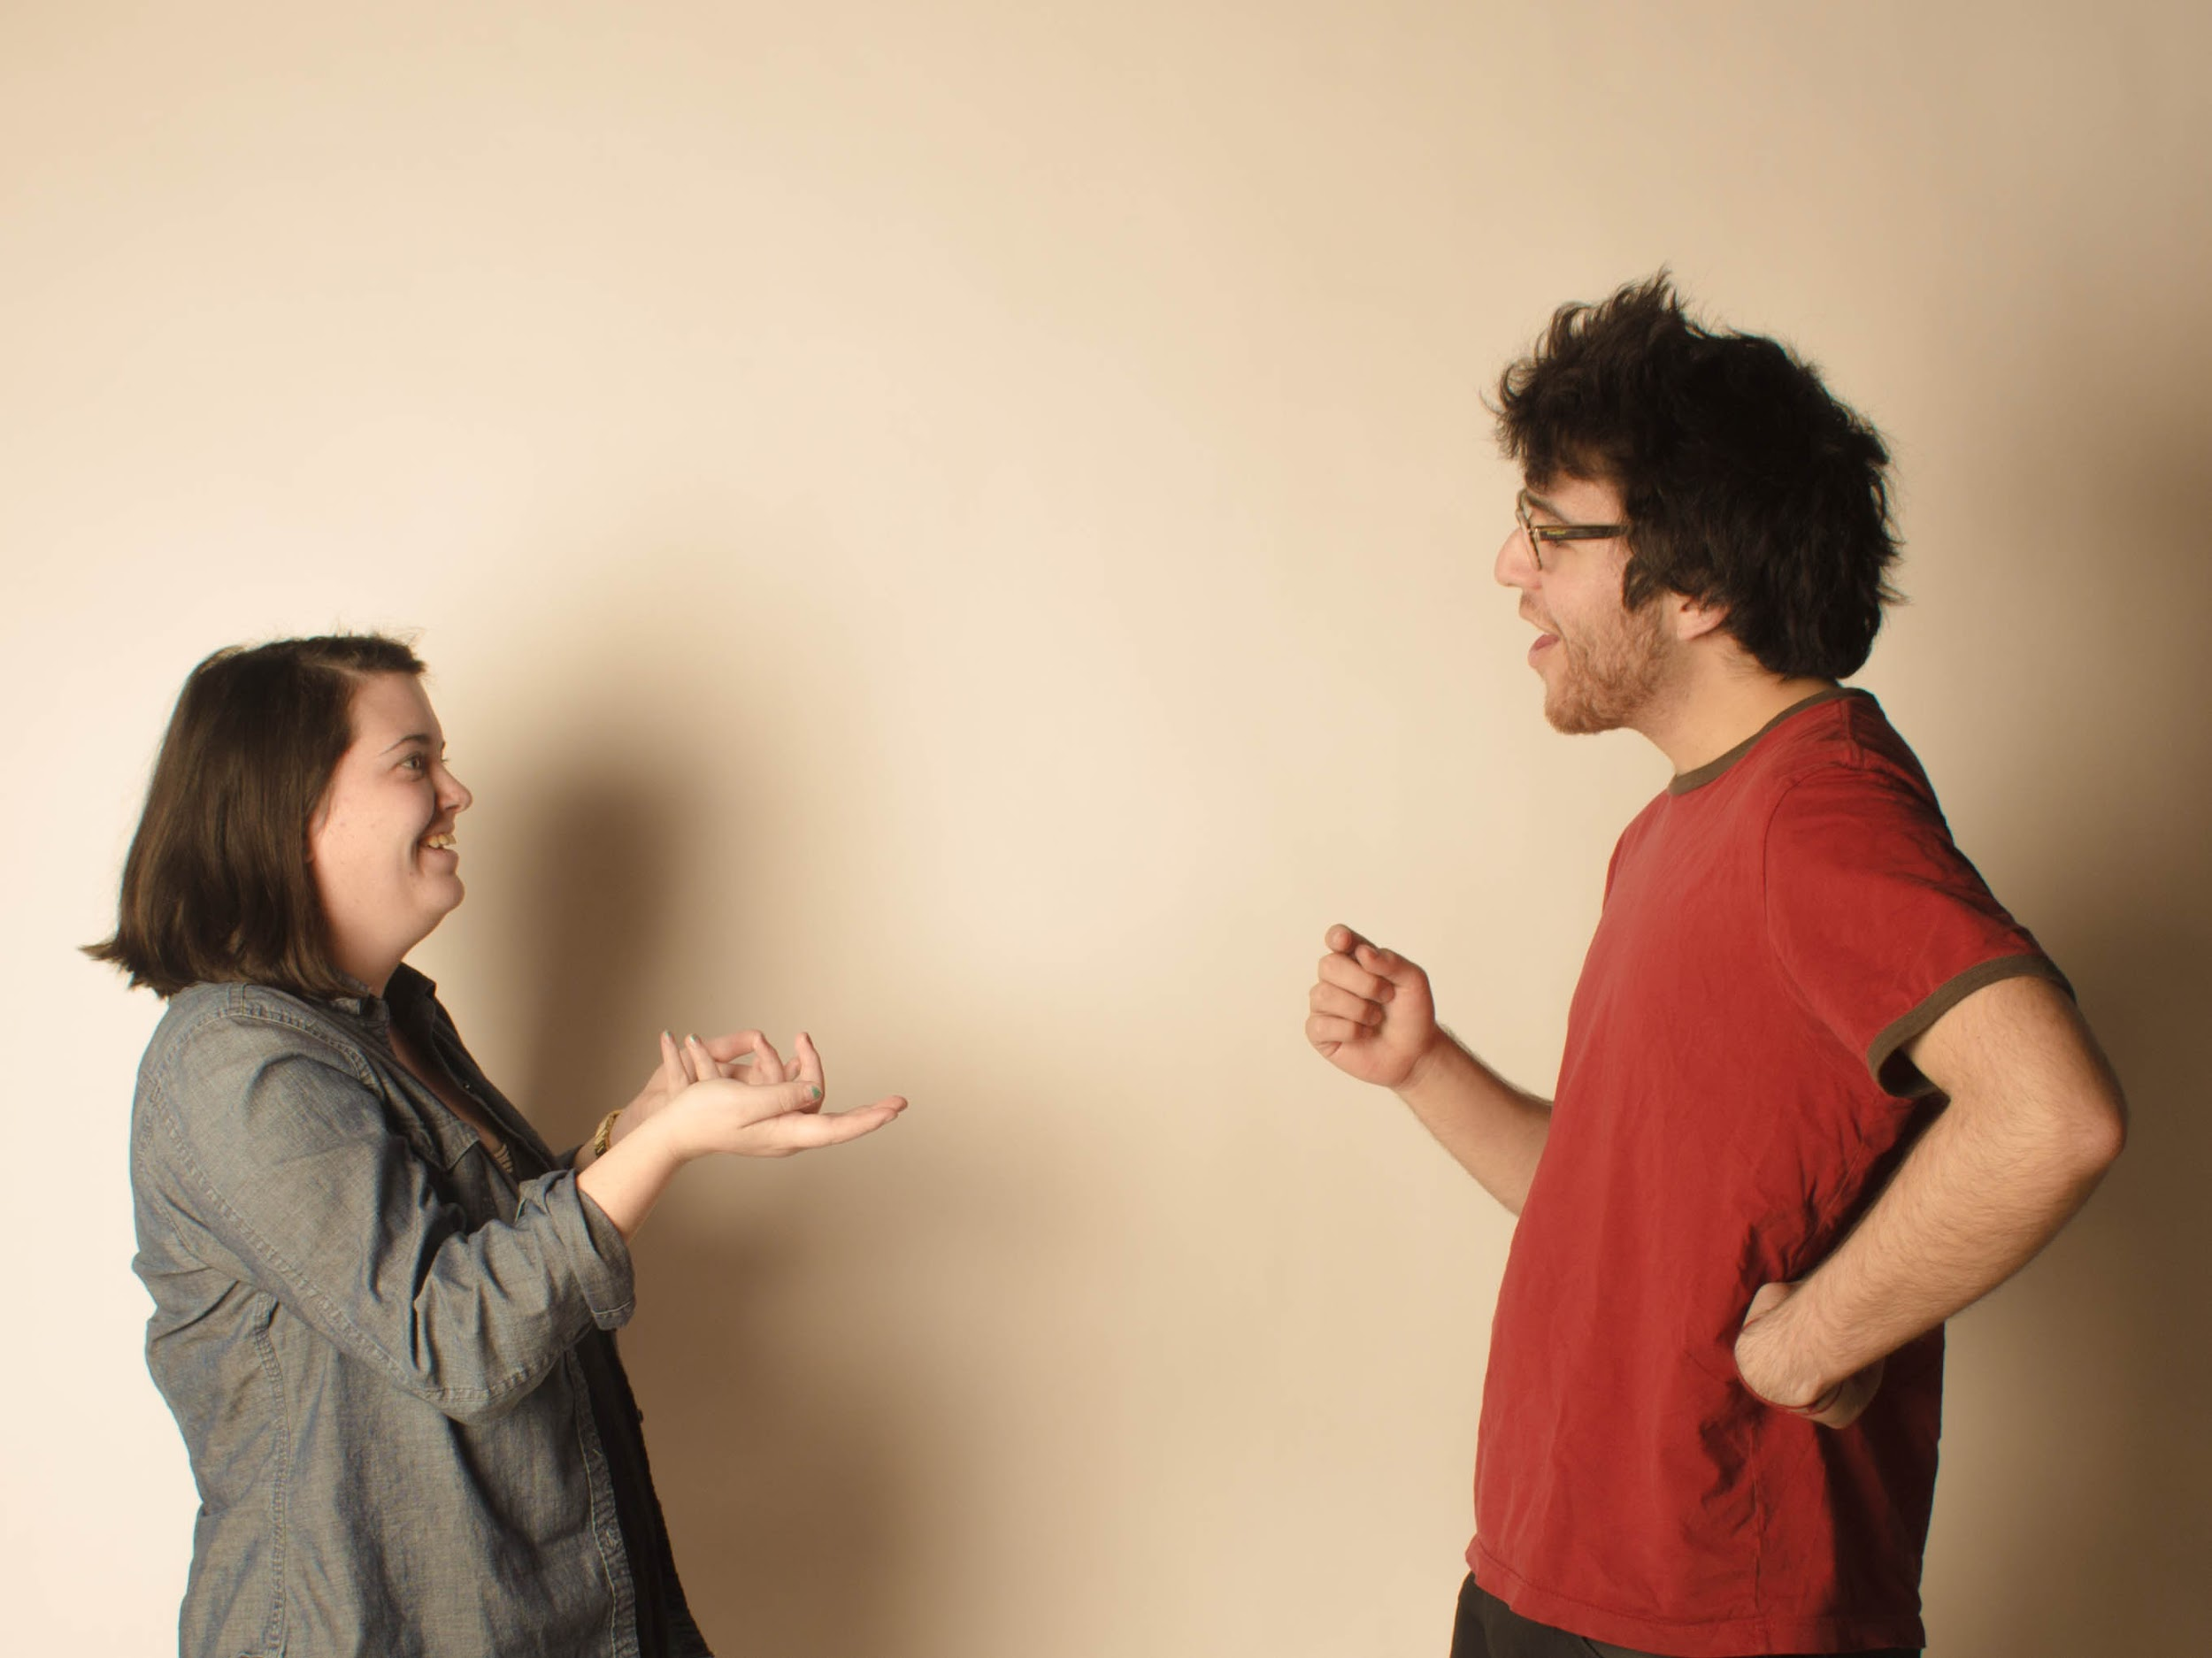
Americans ask you how you are, but don’t really want an answer.

Slide 5
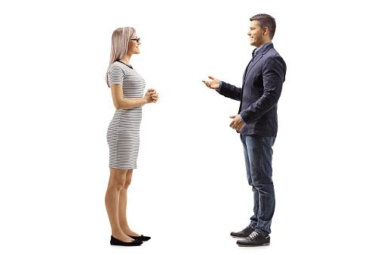
Americans like personal space and stand 2 feet apart while talking. Touching when talking makes Americans uncomfortable.

Slide 6
Americans like to make eye contact when talking.

Slide 7
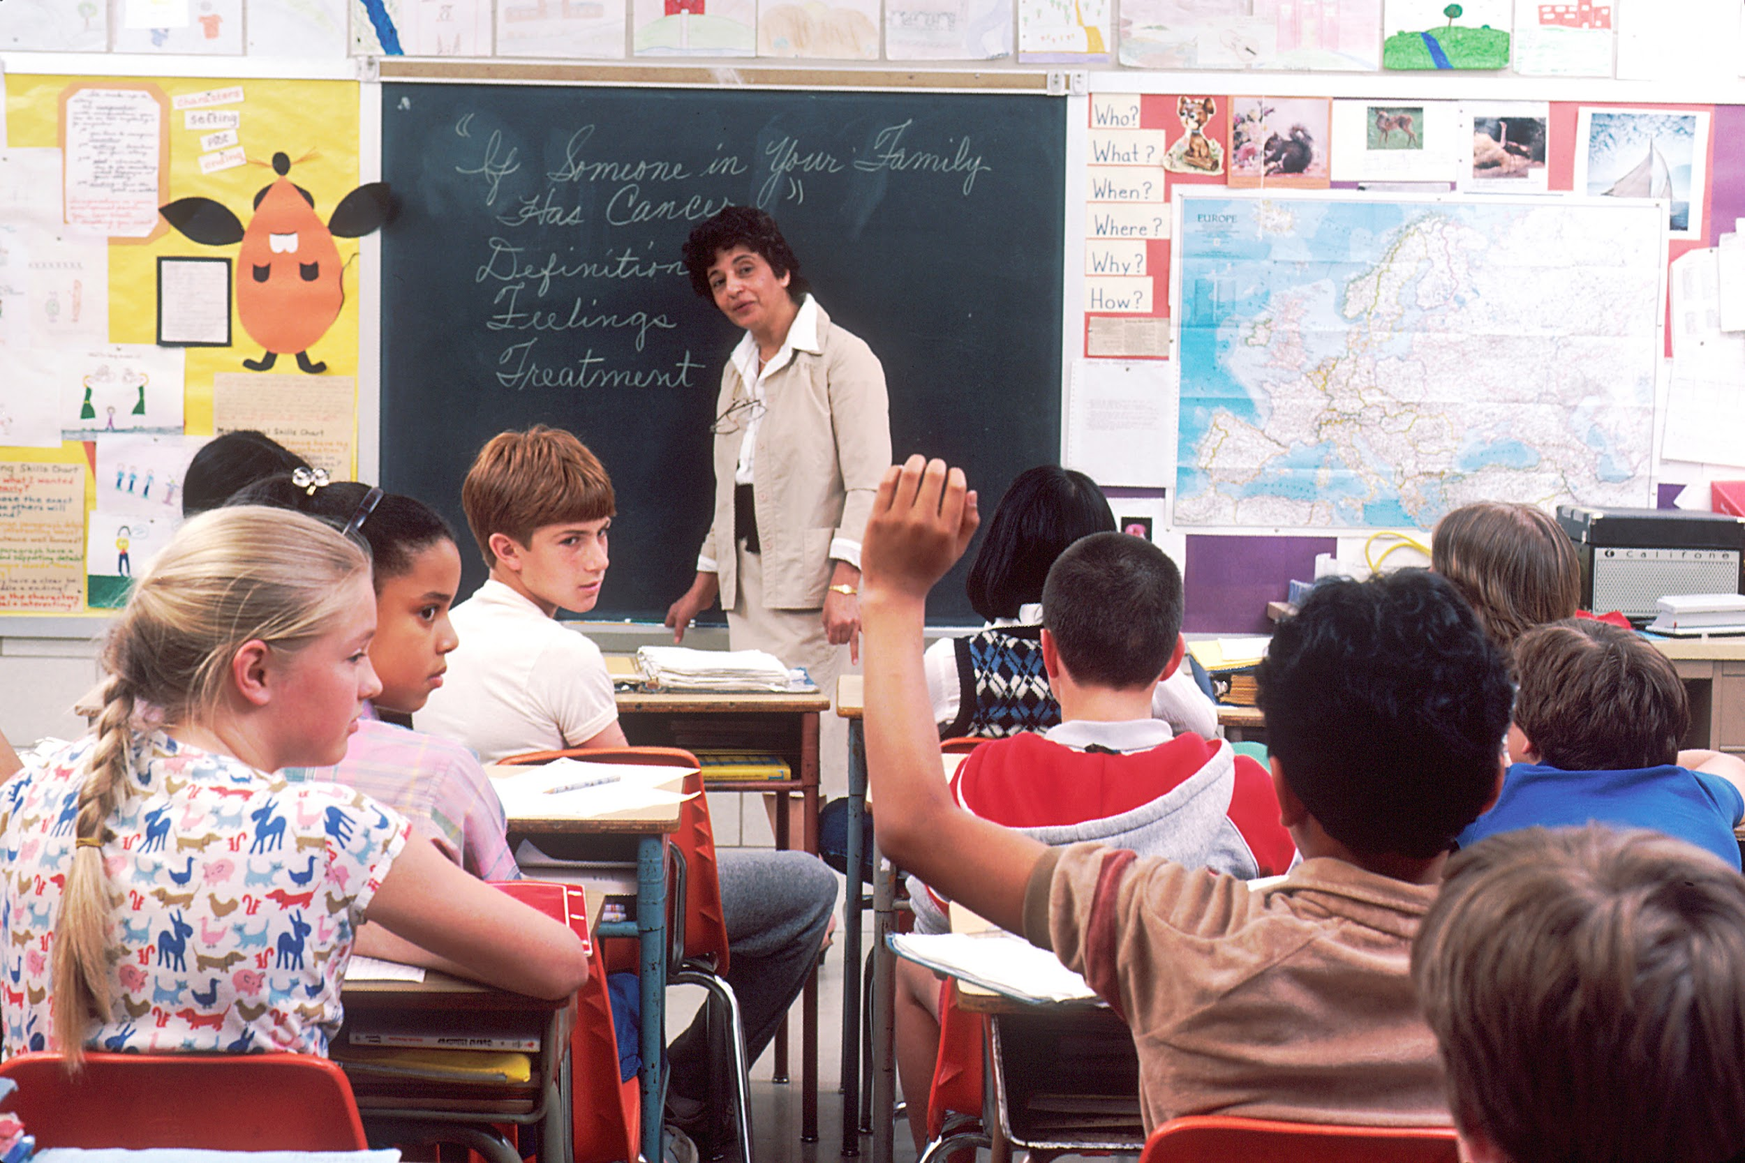
American students are expected to attend school everyday and participate in class activities.

Slide 8
Americans are uncomfortable talking about how much money they make and how much they paid for their things.

Slide 9
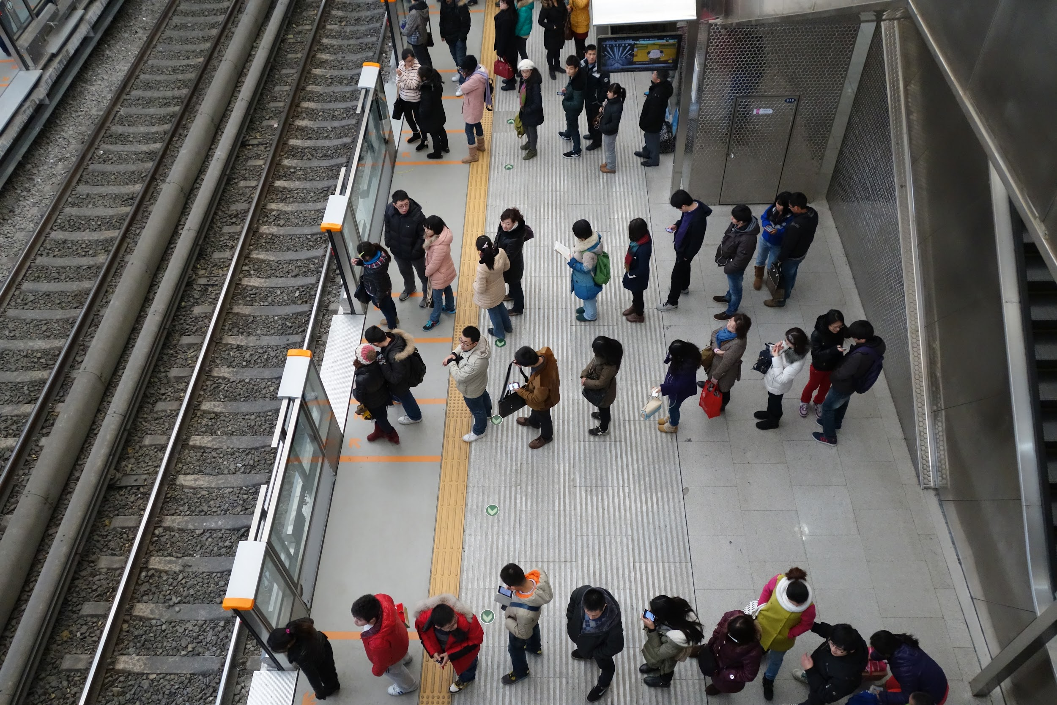
Americans wait their turn in line.

Slide 10
Americans value their independence.

Slide 11
Americans like to joke, smile, and make small talk.

Slide 12
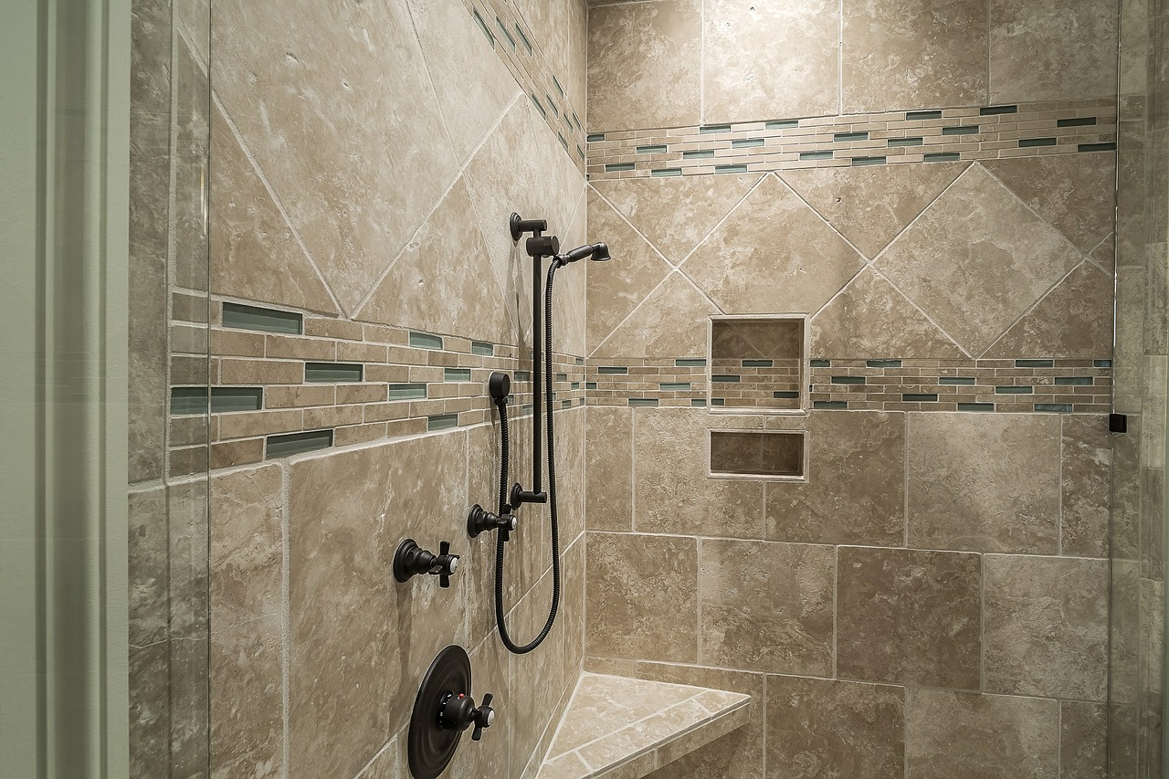
Americans value personal hygiene and being clean.

Slide 13
American women shave their legs and underarms.

Slide 14
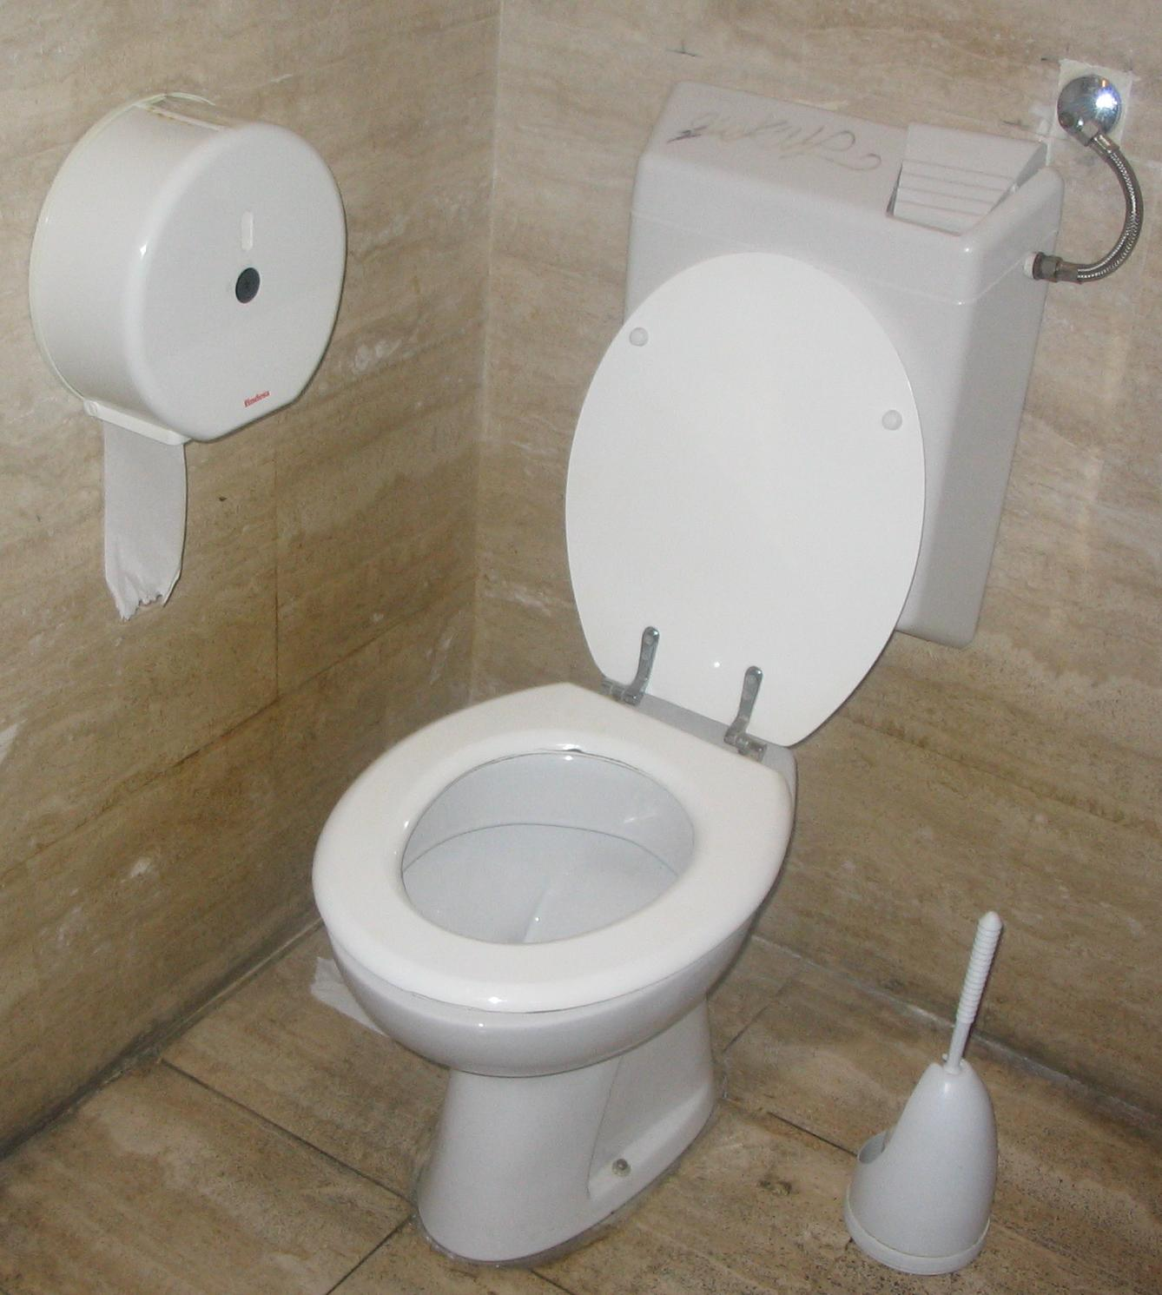
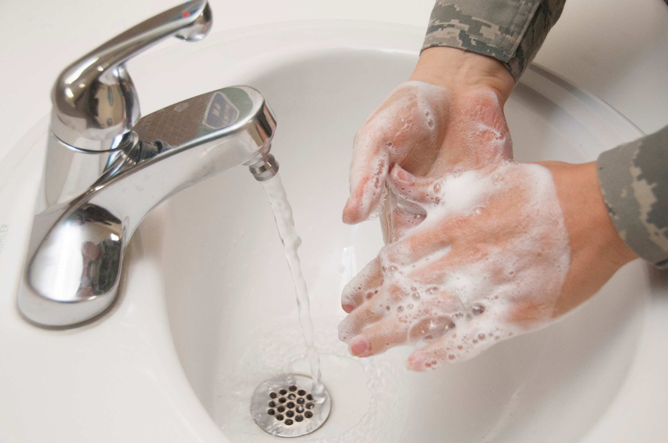
It is safe to flush the toilet paper in American plumbing, but don’t flush any other paper products. Americans also wash their hands after using the bathroom.

Slide 15
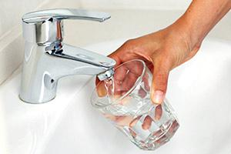
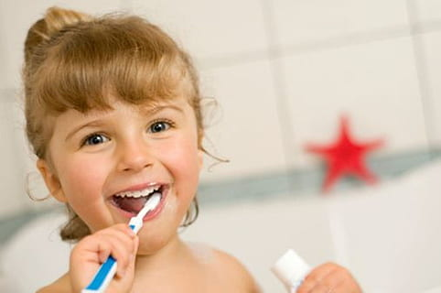
American tap water is safe for drinking and for brushing teeth.

Slide 16
Americans love their pets and see them as part of the family.

Slide 17
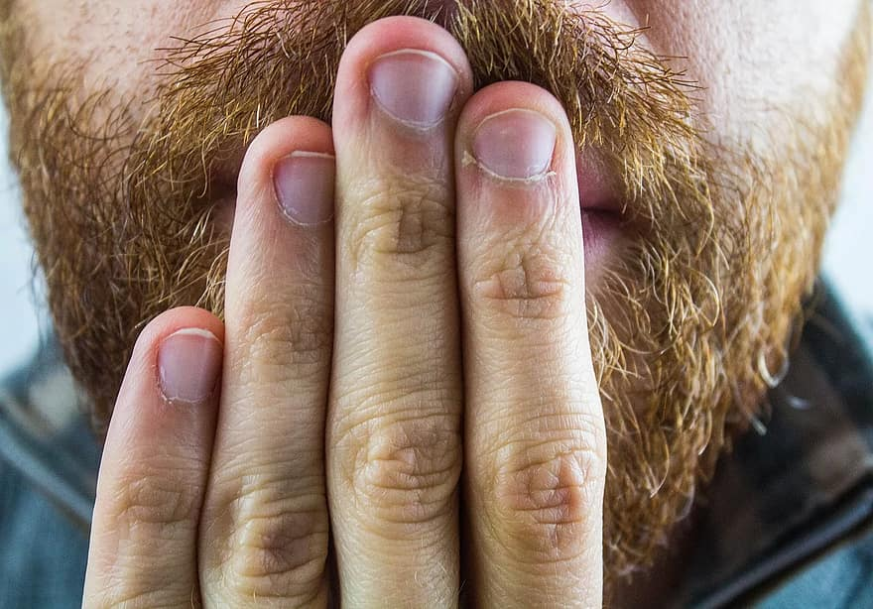
Americans eat with their mouths closed and don’t burp at the table.

Slide 18
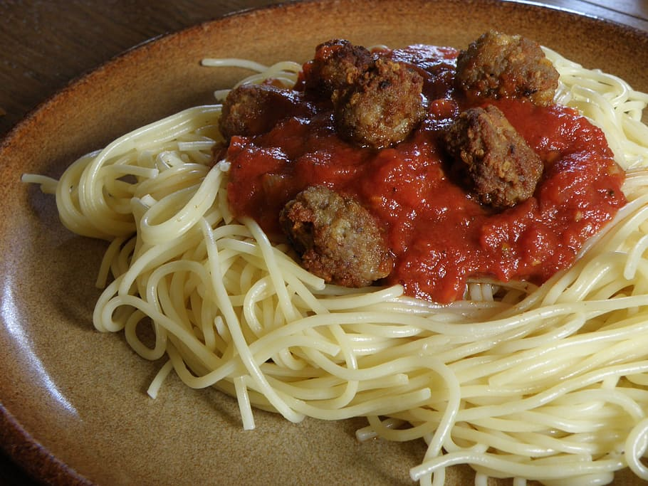
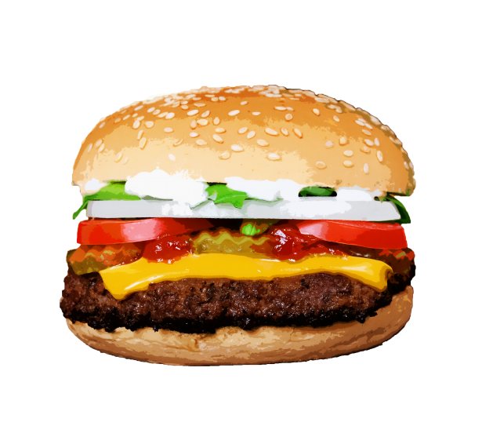
Americans eat 3 meals a day, and eat fast
food with their hands.

Slide 19
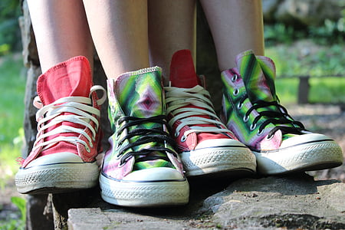
Americans usually keep their shoes on when they visit other homes.

Slide 20
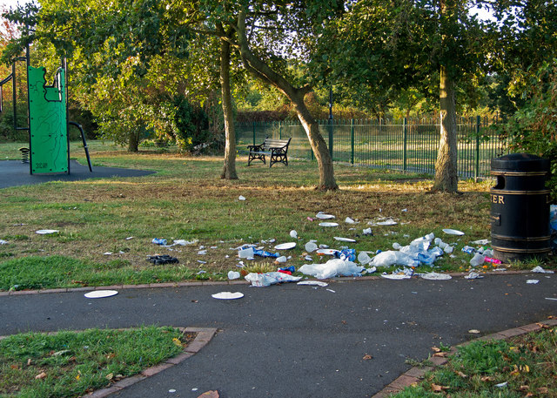
Americans generally don’t like to litter. There are laws against littering.

Slide 21
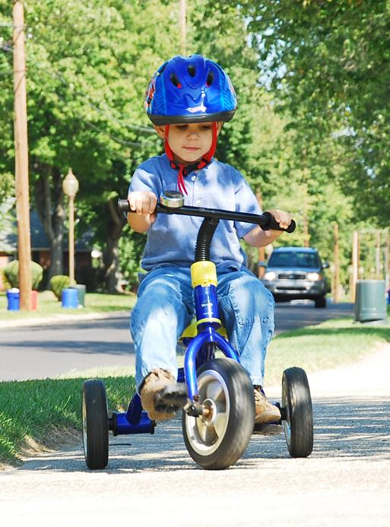
Americans value safety.

Slide 22
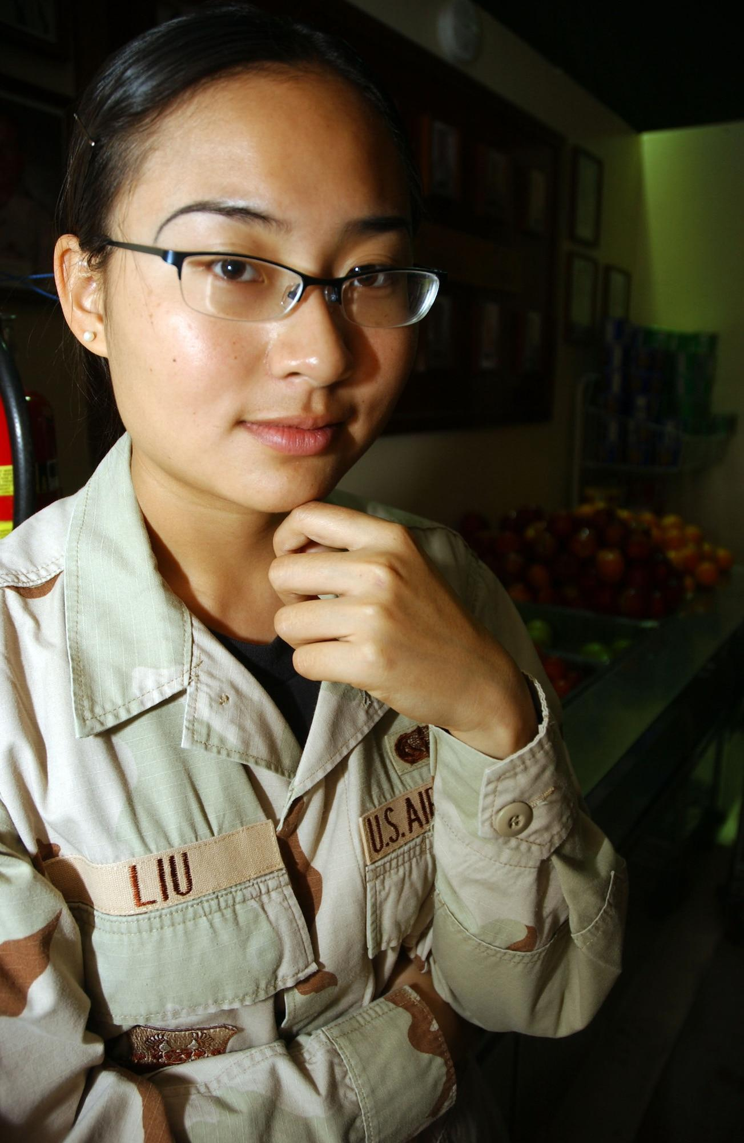
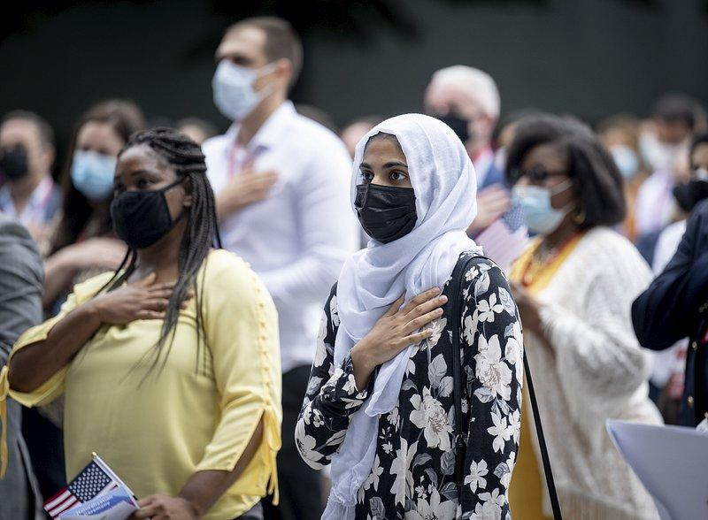
Americans try to avoid words that are offensive to other races, cultures, or religions.

Slide 23
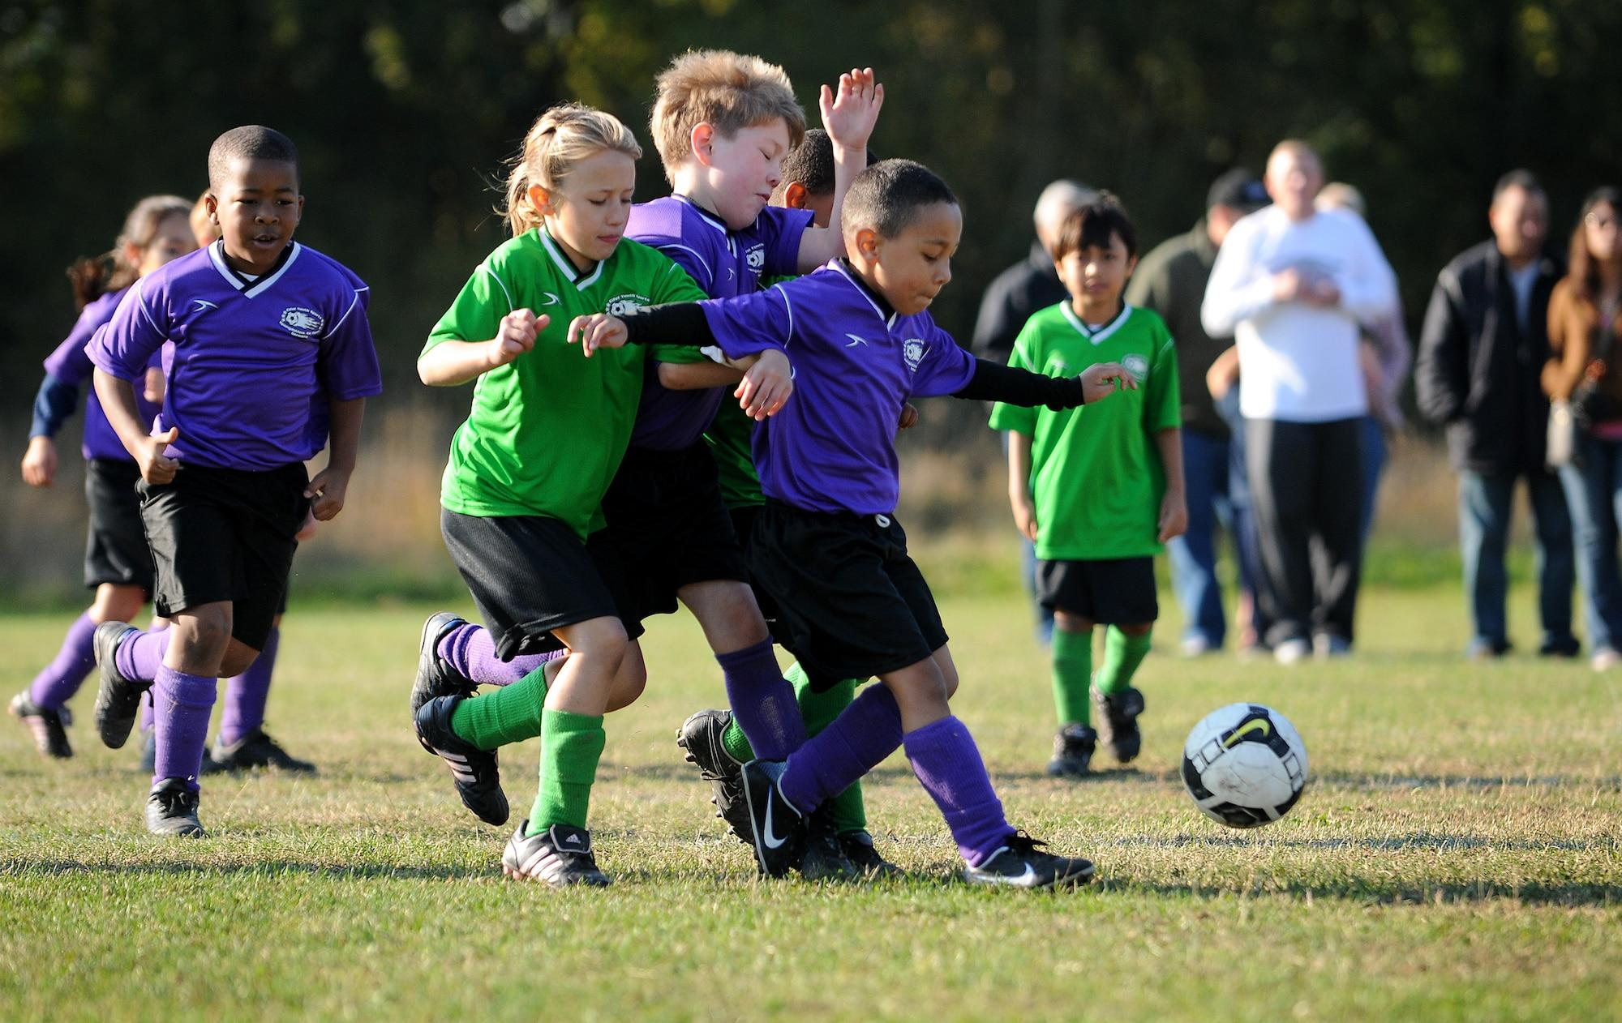
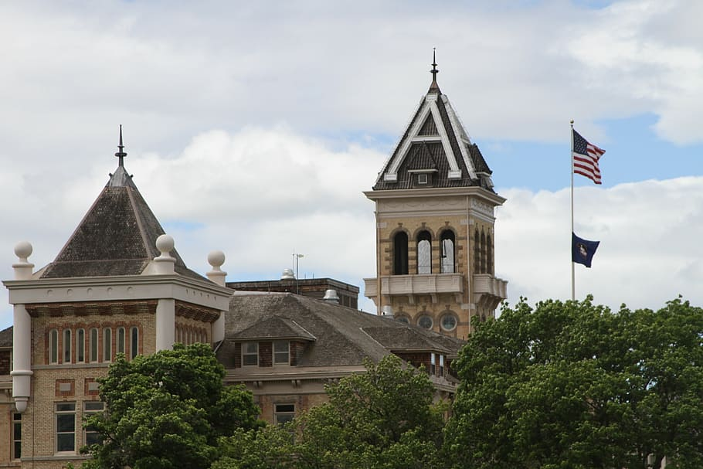
Americans are competitive.

Slide 24
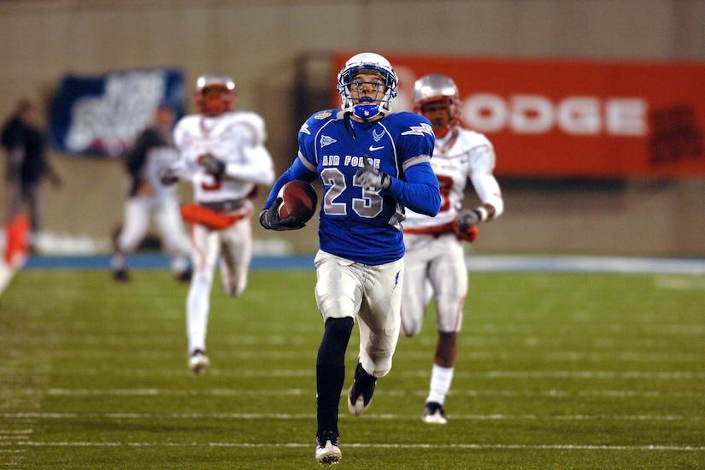
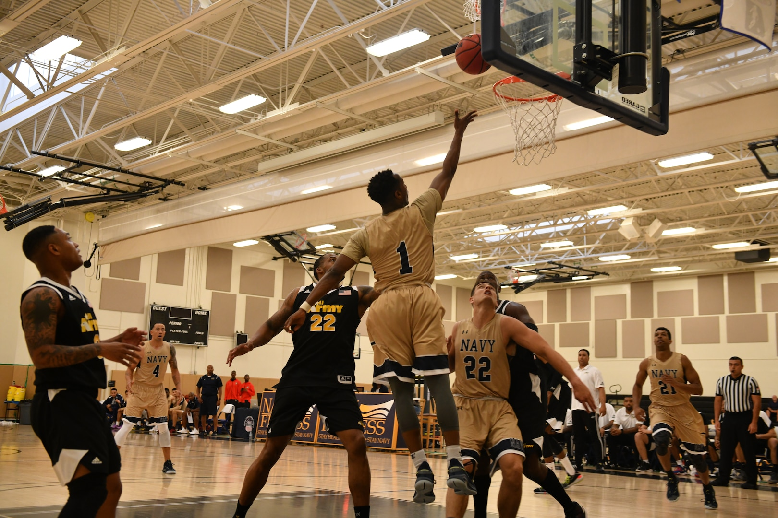
Americans love their sports.

Slide 25
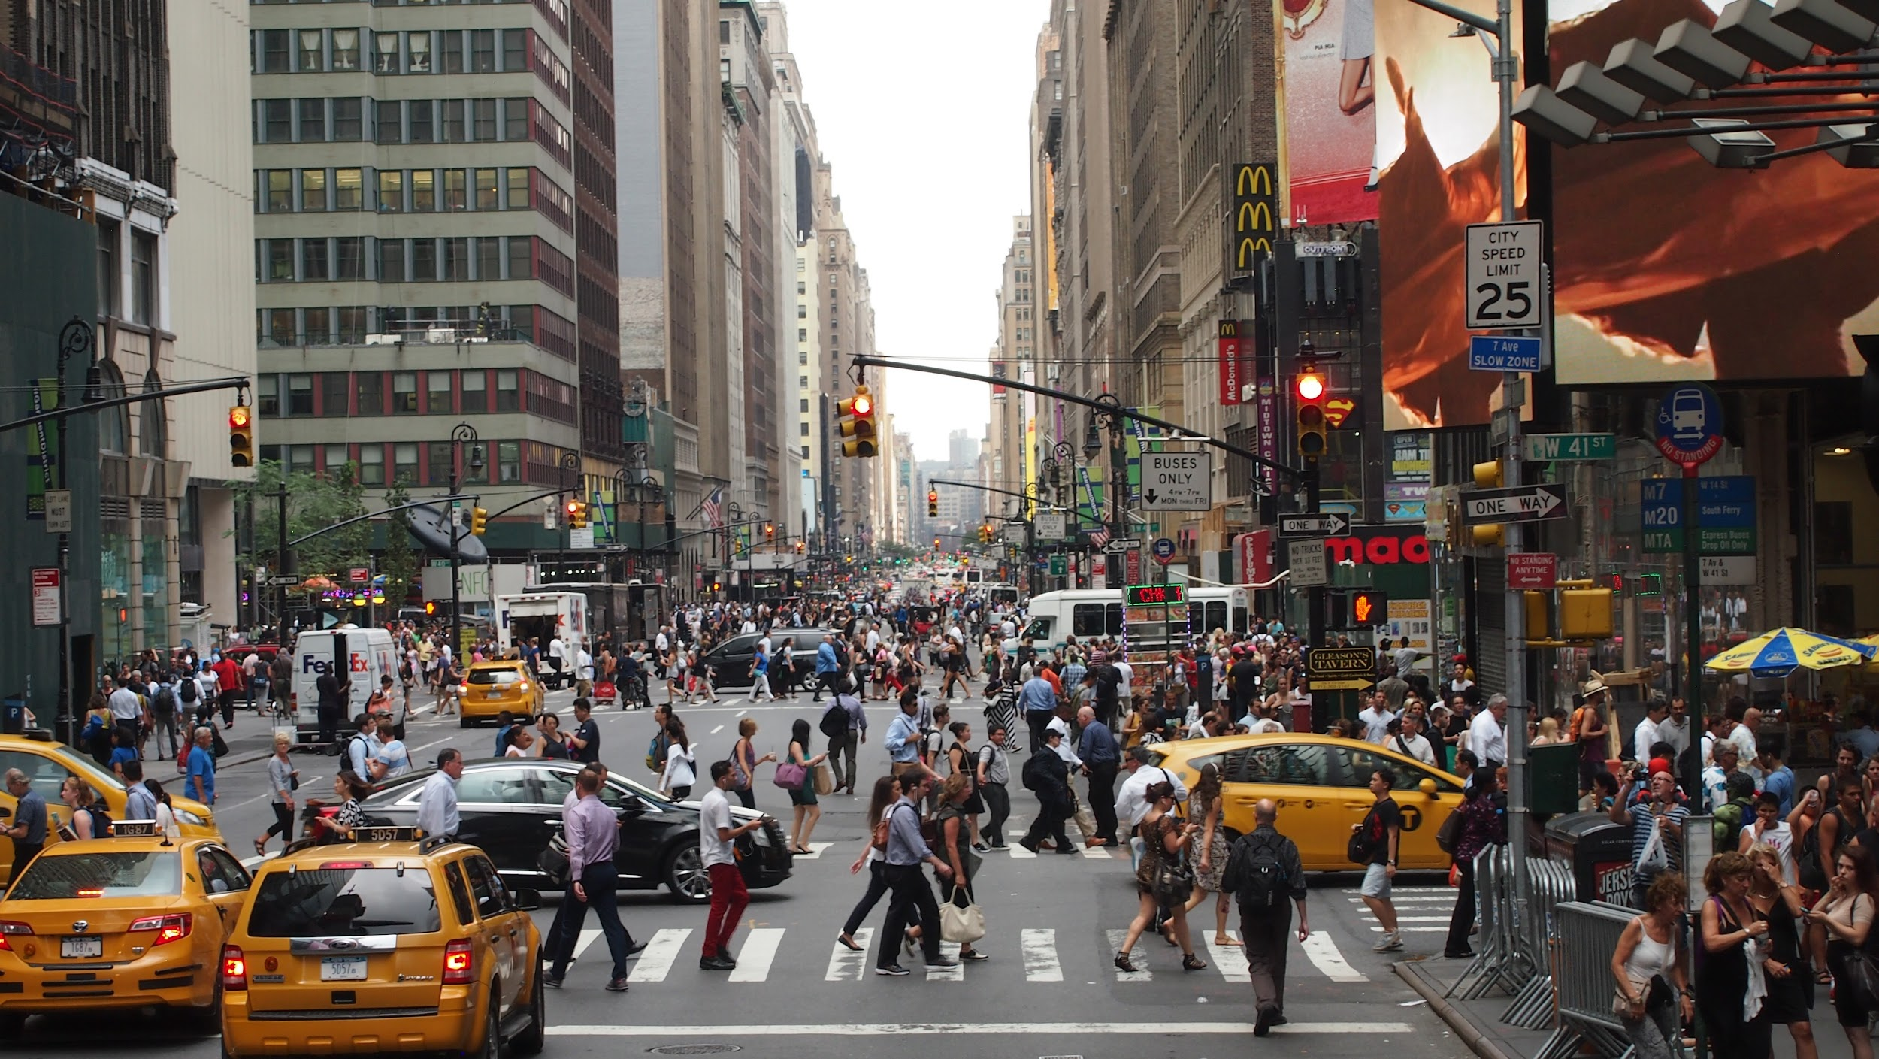
Americans are always ‘on the go’.

Slide 26
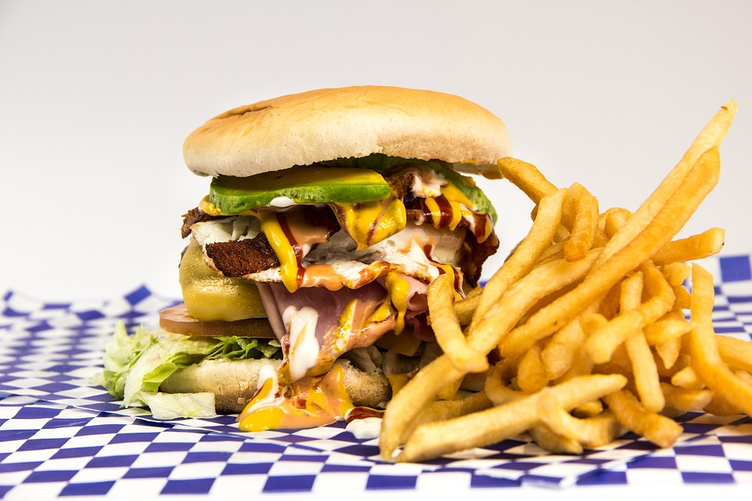
Americans think and dream BIG.

Slide 27
Sources:
https://www.interexchange.org/american-culture/cultural-customs-us/
https://harrisburg.psu.edu/international-students-office/guide-american-culture-etiquette
https://www.listenandlearn.org/the-teachers-handbook/top-5-aspects-of-us-culture-that-esl-students-should-know-about/

